Slide 1
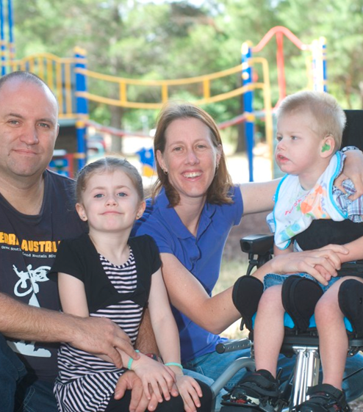
National Disability Insurance Scheme
Scheme overview and implementation update
Cath Halbert
Group Manager, National Transition Office
National Disability Insurance Agency
February 2014

Slide 2
A new way of delivering disability support
Supports tailored to individual needs
Insurance approach for more stable long term costs and better outcomes
Choice and control is central
Needs driven rather than rationed funding
Delivered in local community
Working towards national coverage

Slide 3
Three key pillars underpin NDIS design
Insurance Approach
Supports economic and social participation. Mobilises funding for early intervention Estimates and manages resource allocation based on managing long term costs across the life-course of individuals Shares the cost of disability across the community
Choice and Control
Participants determine how much control they want over management of their funding, supports and providers Scheme gives effect to certain obligations under the Convention on the Rights of Persons with Disabilities - including respect for their worth, dignity and to live free from abuse, neglect and exploitation
Community and Mainstream
People are supported to access and coordinate community and funded supports The scheme will not duplicate or replace mainstream services Effective interface with mainstream and community supports is central to the sustainability of the Scheme

Slide 4
Principles and objectives
Support independence, social and economic participation – not passive
Provide reasonable and necessary supports, including early intervention
Enable people to exercise choice and control in pursuit of goals, and in planning and delivery of their supports
Facilitate nationally consistent approach to access, planning and funding of supports
Promote provision of high quality, innovative supports to maximise independent lifestyles and full inclusion in the community
Give effect to obligations under international conventions

Slide 5
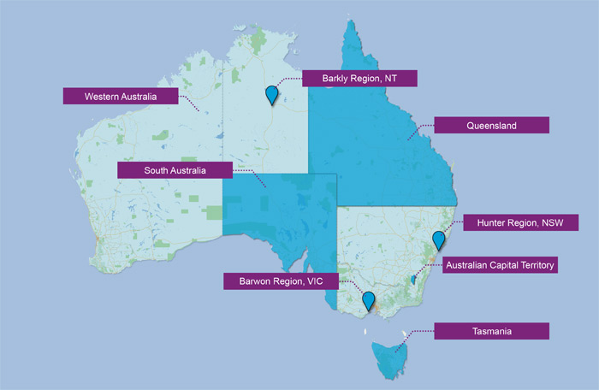
7 trial sites
1 July 2013, the first stage of the NDIS commenced in
Tasmania
South Australia
The Hunter in NSW
The Barwon area in Victoria
The ACT and the Barkly region of the NT join the first stage in July 2014
Western Australia commences a two-year pilot in July 2014

Slide 6

Accessing the Scheme
People with disability who meet the access requirements will become participants in the scheme
NDIS has a wide gateway to introduce people to the scheme through multiple channels and touch points
People in trial sites can use MyAccess Checker to get an indication about whether they may be able to access assistance from the scheme
Gradual intake of participants into the scheme

Slide 7
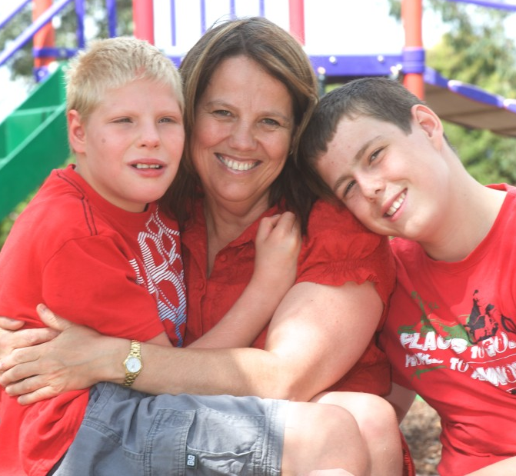
Access requirements
    Accessing assistance from the scheme requires that a person must:
    be under 65 years of age;
    be an Australian citizen or permanent resident and living in the trial site;
    have a permanent disability - the disability must have a big impact on day to day life and on the person’s ability to participate in the community; or
    meet early intervention requirements – reducing individual’s future needs for supports in relation to disability

Slide 8
Individual plan and budget for supports
My Plan
+
Other supports
(provided by
other systems,
family and friends)
+
Individual goals
NDIS funded supports

Slide 9
NDIS funded supports
NDIS funded supports may include
  informal care arrangements and involvement in social, and community activities
  supports needed to enable families and carers to undertake family activities together
NDIS funded support must be ‘reasonable and necessary’ AND:
    focus on the goals and aspirations of the participant AND
    foster independence, social and economic participation AND
    be evidence based AND
    represent value for money
NDIS funded supports coordinate with, but do not replace or duplicate, informal or mainstream supports

Slide 10
Informal and mainstream supports
Informal supports are those that are reasonably expected to be provided by family, carer or community
  Need to take into account what family, carers and community are willing and reasonably able to provide
Mainstream supports are those provided by other government agencies and funding organisations such as Health, Education, Employment, and mental health

Slide 11
How the NDIS works with other mainstream systems
The NDIS is not intended to replace the supports or services provided by other mainstream systems.
Wherever possible the Scheme assists participants to access mainstream systems.
Key principles determine whether the Scheme or another system is more appropriate to fund particular supports for participants.
A participant’s plan includes supports the Scheme will fund, plus those supports that are the responsibility of the other systems.

Slide 12

The interface principles between the NDIS and Mental Health
The NDIS has responsibility for funding participant supports that help the participant to manage ongoing functional impairment that results from their disability.
This includes:
supports to enable activities of daily living and participation
community-based, non-clinical supports

Slide 13
The Mental Health System is responsible for..
The mental health system is responsible for the diagnosis and treatment of psychiatric conditions and mental illness.
This includes:
  diagnosis and clinical treatment (in the community or in a health setting)
  residential care, including inpatient treatment or clinical rehabilitation
  early intervention

Slide 14

Learning from trial sites will be crucial
Learning based on experience will drive improvement
Openness to feedback will help shape the Scheme
The Scheme will be continuously reviewed and improved
Continuous improvement supports long-term sustainability

Slide 15
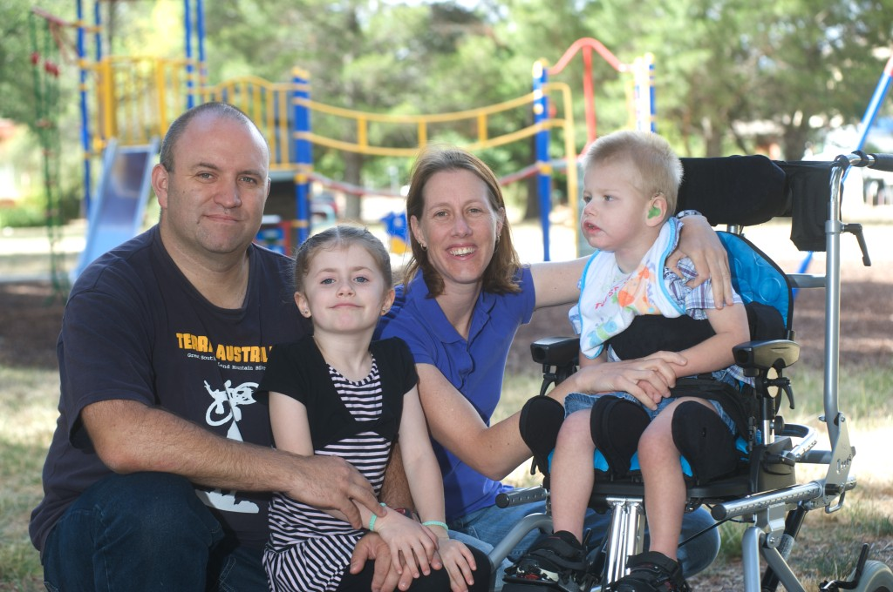
Progress to date has been good
Nationally:
Over 28,000 people - MyAccess Checker
Website has around 2,000 visitors daily
Our shopfronts have had over 3,600 visitors
More than 5,900 access requests have been submitted
Over 2,500 individual plans have been completed by end of 2013
People accessing the scheme report high levels of satisfaction

Slide 16
Progress to date – mental health
NDIS Participants - to date 2% of participants deemed eligible for the Scheme identify as people with primary disability type of ‘psychiatric’
Program transitions – number of state and Commonwealth mental health programs transitioning fully or part into the Scheme
Ongoing sector engagement – to inform how the Scheme can best support participants with a permanent psychosocial disability.
  Agency holding a number of workshops and forums;
  Funded Mental Health Council of Australia to help build the capacity of mental health sector and assist in understanding the Scheme

Slide 17
WA Update
One site secured in Midland
Appointment of Trial Site Manager - Marita Walker
Further recruitment is underway for Directors of Engagement and Service Delivery
Working closely with WA Government on:
  Sector Development and provider readiness
  Client and program mapping
  Communication to consumers
Expecting at least 4,000 people to transition into the Scheme over two years
  Working with WA Government to establish what order people will come into the Scheme

Slide 18
To be successful the NDIS must
  Keep the three pillars in balance
  Ensure the Scheme is sustainable
  Ensure the delivery of the Scheme is both efficient and effective
  Improve outcomes for people with a disability

Slide 19
Questions?

